Slide 1
Emoji Equity – Mar 05
Agenda
Case Study C.2 Emoji Equity
Begin / Complete Today
Marks Spreadsheet
Individual Conferences
Upcoming
t.b.d.

Slide 2
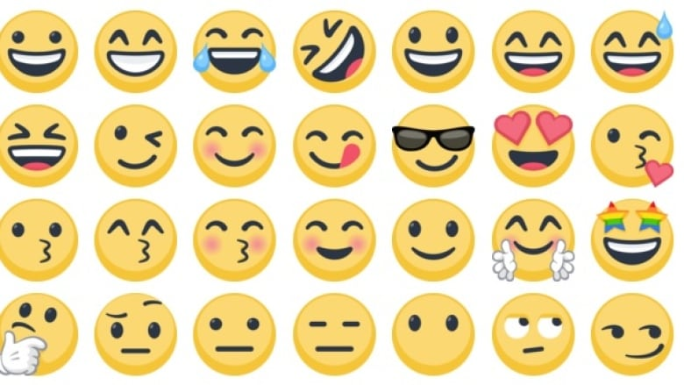

Slide 3
